Slide 1



TRACKER-PRO: A Smart Phone Number Tracking System
Developed by: Rahul KhatiTech Stack: Python • React.js • Google Maps API • NumVerify • SQLite
Notes:
1

Slide 2




Unlocking Phone Number Insights
Tracker-Pro is a full-stack web application designed for comprehensive phone number tracking. It provides a seamless experience for users to delve into the details of any given phone number.
Approximate Location
Carrier & Region
Fetch instant details
Visualize on Google Maps
Live User Location
Search History
Instant geo-positioning
Smart recall function
Built with a focus on accuracy, speed, and a modern UI experience, Tracker-Pro aims to redefine how users interact with phone number data.
Notes:
2

Slide 3

Addressing Common Tracking Challenges
Users frequently encounter difficulties when trying to identify unknown numbers or verify contact information. Tracker-Pro offers an all-in-one solution to these persistent issues.
Identifying Unknown Numbers
Verifying Location & Validity
Struggling to put a name to an unfamiliar caller?
Need to confirm where a call originated or if a number is active?
Finding Carrier/Region Details
Managing Past Searches
Curious about the network provider or geographical origin?
Frustrated by losing track of previously investigated numbers?
Tracker-Pro solves all of these with a single, clean dashboard, streamlining the process and providing clarity.
Notes:
3

Slide 4
Project Objective: Powerful & User-Friendly Tracking
Our core objective is to build an intuitive yet powerful tracking tool that delivers critical phone number insights with unparalleled speed and accuracy.
1
Instant Insights
Provides number details in mere seconds.
2
Geographic Conversion
Converts raw coordinates into precise, real-world addresses.
3
Browser-Based Geolocation
Displays the user's live location directly through the browser.
4
Persistent History
Automatically saves the last ten search records for easy access.
5
Optimized API Communication
Ensures rapid and efficient data retrieval from all APIs.
Notes:
4

Slide 5

Robust Tech Stack for Seamless Performance
Tracker-Pro leverages a modern and efficient tech stack to ensure high performance, responsiveness, and reliability.
Frontend:
React.js for dynamic user interfaces
HTML5 & CSS3 for structured and styled content
Axios for efficient API request handling
Backend:
Python (FastAPI / Flask) for robust server logic
NumVerify API for comprehensive phone number data validation and information
Google Maps Geocoding & Reverse Geocoding for precise location data
Database:
SQLite / JSON-based storage for flexible data management
Cloud Services:
Google Cloud Console for managing Maps and Geolocation APIs securely
Notes:
5

Slide 6
Key Features: Comprehensive & User-Centric
Tracker-Pro is equipped with a suite of features designed to provide users with detailed phone number insights and a superior experience.
✔ Validation & Carrier Lookup
✔ Exact Location Coordinates
Verifies numbers and identifies network providers.
Extracts precise geographical data for any number.
✔ Reverse Geocoding
✔ User Live Geolocation
Translates coordinates into human-readable addresses.
Pinpoints the user's current location instantly.
✔ Google Maps Integration
✔ Search History
Direct link to view locations on Google Maps.
Maintains a record of the last 10 tracked numbers.
✔ Modern UI
✔ Fast Backend Response
Clean, minimal, and intuitive user interface.
Delivers quick results with optimized JSON output.
Notes:
6

Slide 7

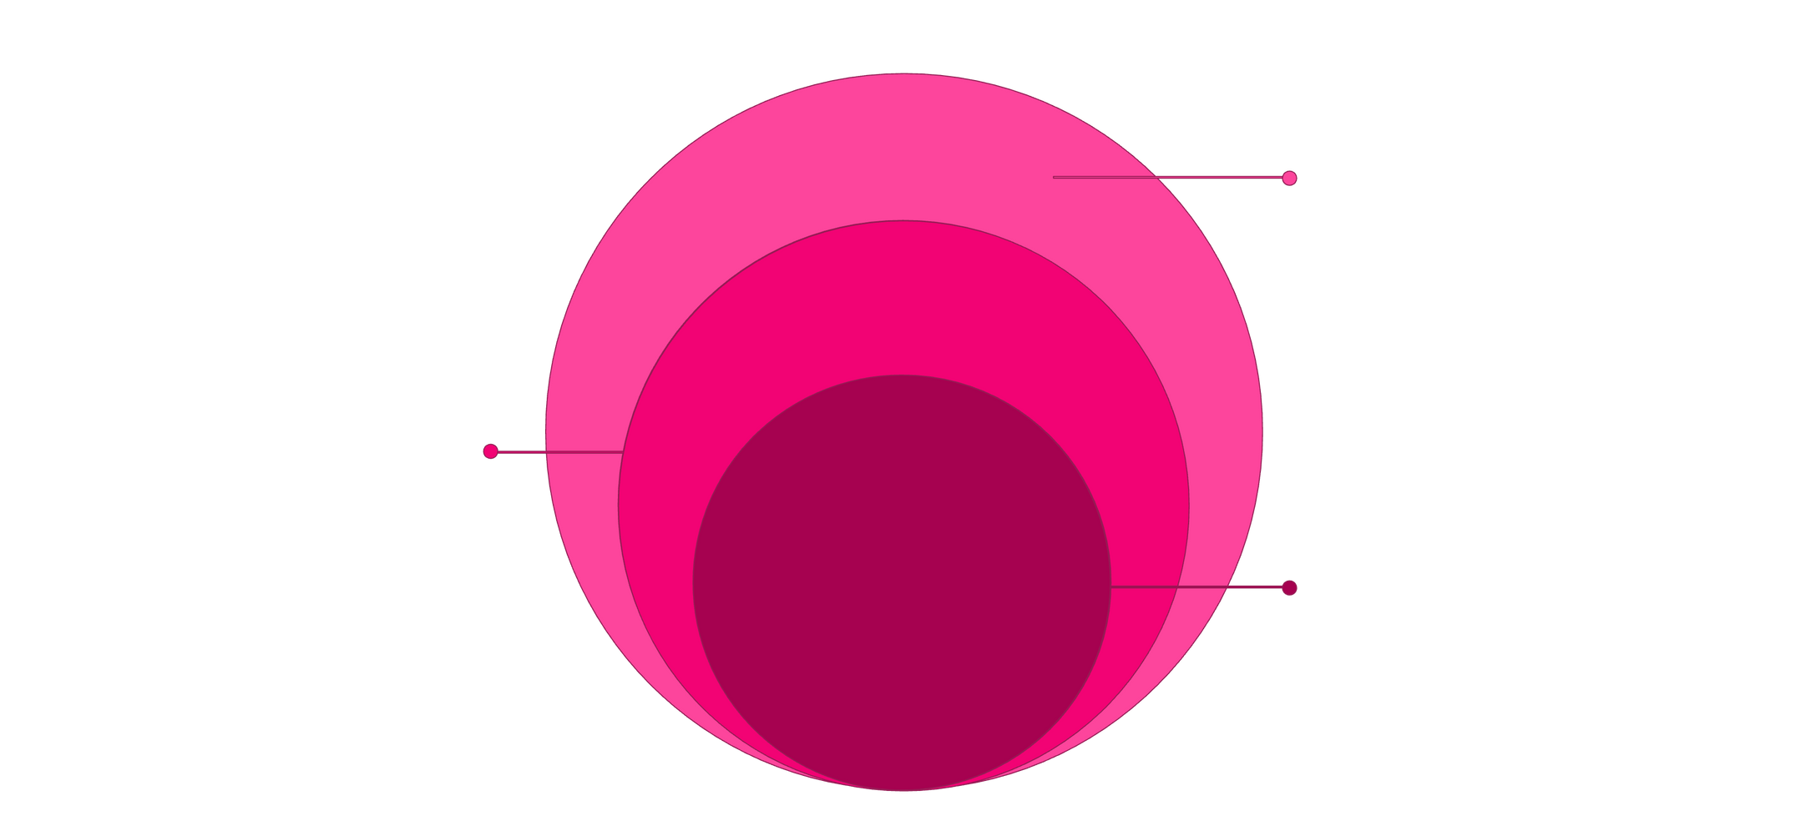
Streamlined System Architecture
The system architecture of Tracker-Pro is meticulously designed to ensure a smooth, end-to-end flow, prioritizing performance and clarity from user interaction to data storage.
External Services & Storage
NumVerify, Google Maps, and SQLite/JSON storage
Backend API
FastAPI handles requests and integrates services
Frontend UI
React.js sends requests via Axios
This robust structure allows for efficient communication between all components, providing a seamless and responsive user experience.
Notes:
7

Slide 8







Backend Logic: Precision in Every Step
The backend of Tracker-Pro orchestrates a series of precise steps to process user queries, ensuring accurate and comprehensive information delivery.
User Input
A mobile number is entered by the user.
NumVerify Request
Backend dispatches the number to the NumVerify API.
Data Validation & Fetch
NumVerify validates the number and retrieves country, carrier, and region.
Google Maps Integration
Coordinates are sent to the Google Maps API.
Address Conversion
Maps converts coordinates into a readable physical address.
Frontend Response
A structured JSON response is sent back to the frontend.
History Storage
The processed data is automatically saved in the search history.
This clear, fast, and optimized architecture ensures efficient data flow and accurate results.
Notes:
8

Slide 9

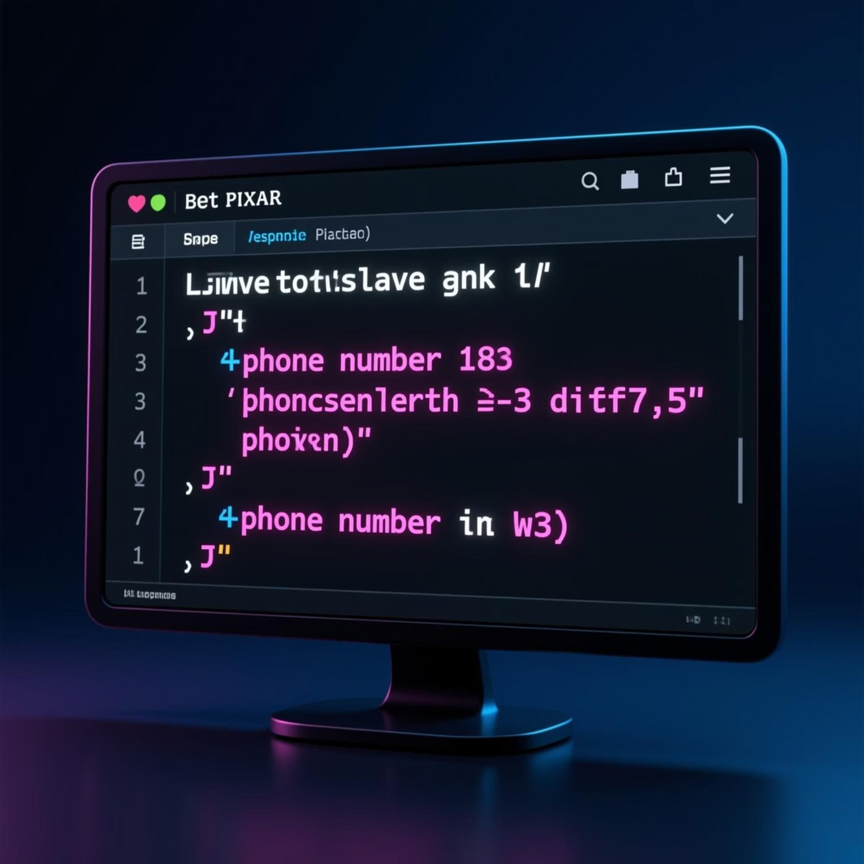
Results & Output: Clarity in Data
Tracker-Pro delivers a comprehensive and visually appealing output, transforming raw data into actionable insights for the user.
Tracker-Pro generates:
Clean and precise carrier details
Accurate geographical coordinate information
The exact address associated with the number
Real-time live location of the user
An automatically generated, clickable Google Maps link
A beautiful and intuitive frontend UI display
These outputs are presented with a clean interface, making complex data easily understandable and actionable.
Notes:
9

Slide 10










Conclusion & Future Enhancements
Tracker-Pro stands as a powerful and intuitive tracking solution, seamlessly integrating various APIs with Python and React to deliver instant, accurate insights into phone number details.
Multi-user Login System
Real-time Movement Tracking
IP-Based Tracking
Detailed Analytics Dashboard
SMS Alert Integration
Thank you for your time. This project was developed by: Rahul Khati.
Notes:
10

